Slide 1
Python project: ABC classification
Phuong Tang – University of Canterbury
Teacher: Liam Laing

Slide 2
Short introduction
This project is mainly focus on coding for ABC classification (80/20 rule) and apply it for analysing specific inventory data of raw materials of a FMCG company.
The ABC analysis provide a mechanism for identifying items that will have a significant impact on overall inventory cost. Based on that, the organization will apply appropriate order patterns to avoid high inventory cost for the warehouse.

Slide 3
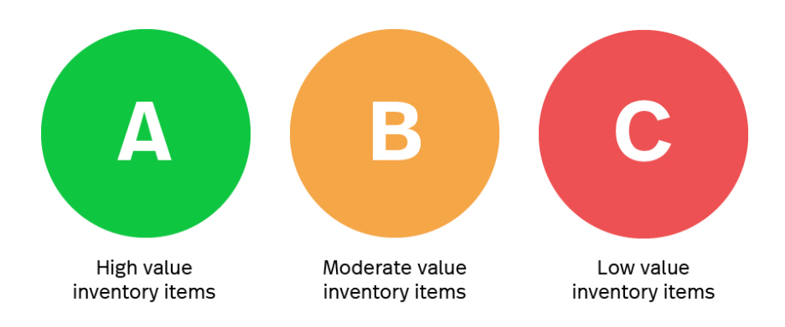
Short introduction
For example: ‘A’ items consume high value of organization (let’s say: 20% of the number of items will account for 80% of the inventory value), therefore a frequent order pattern (e.g. ‘just-in-time’ or 1-week order) are required for these kind of items

Slide 4
Tools and libraries
Pandas
Numpy
Matplotlib
Tkinter
Coding followed Object-Oriented Programming paradigm
Quote: Please see READ_ME file for how it works

Slide 5
Development process: Issues and solutions
Issue 1: using Pandas for data analysis → Static model
Solution: using GUI to get interaction with users about required threshold for each class.
Issue 2: how GUI and Pandas play together?
Solution: combine Pandas with Object Oriented Programming.
Considering “Stock_file” as a class, we have 2 benefits:
Each class have its own attributes. This allows us access different attributes and different iterations of the dataset.
Pandas can help us to create new calculated columns for the dataset. Then, OOP can help us to reuse these columns easier since they now exist as a method in the Class.

Slide 6
Future development
The versatile of ABC analysis:
Inventory management
Customer service (find the most valuable customers based on their sale volumes/sale revenue)
Shopping (find the most valuable products in grocery store)
Quality problems (what are the major quality problems. In each problem, what is the main causes. ABC analysis allows managers to strictly deal with main causes of problems)
New features could be added such as: adding different tabs in Tkwindow to process above 4 applications.

